Slide 1
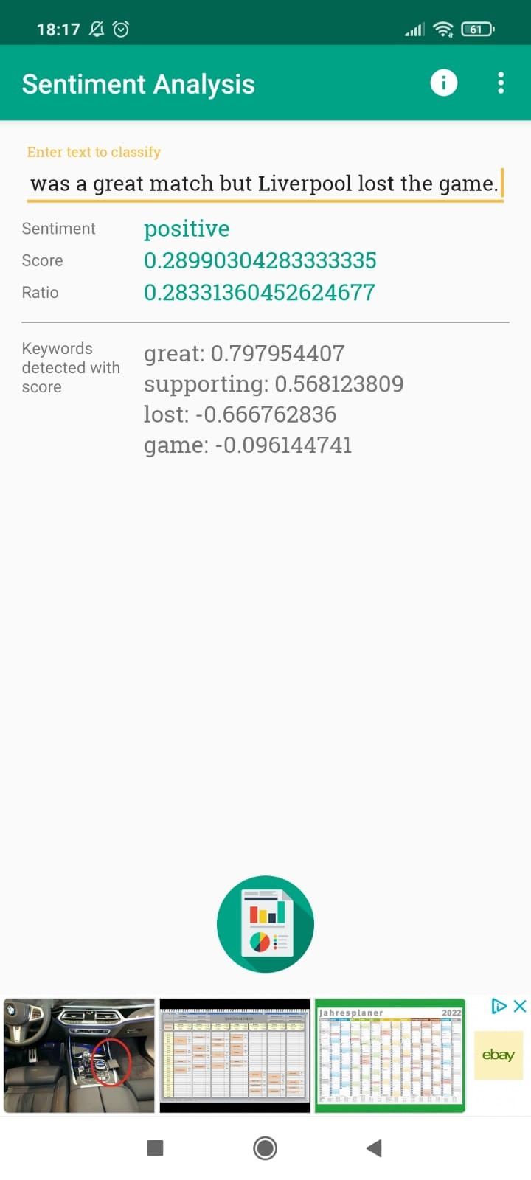
Sentiment Analysis App (Rating 2.7)
Uses n-grams and comparing them with a probability model.
Uses Naïve Bayes model for sentiment classification.
It is very basic and only shows sentiment, score and ratio.
Today is the final match between Liverpool and Dortmund. I am supporting Liverpool. It was a great match but Liverpool lost the game.

Slide 2
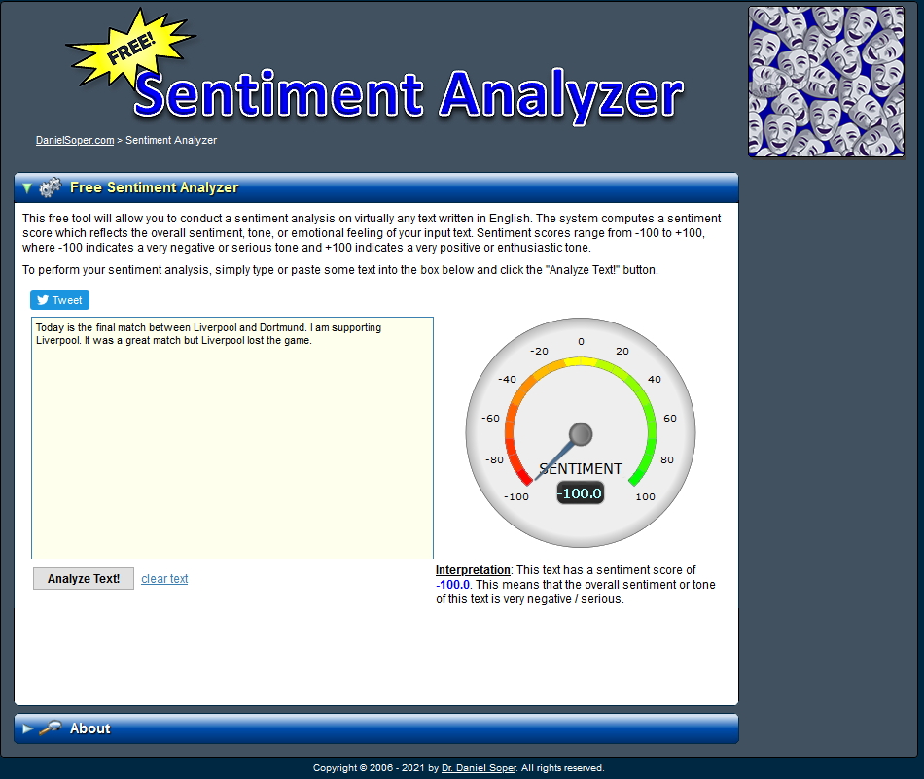
This sentiment analysis tool uses computational linguistics and text mining to identify the sentiment behind text.
It was trained with a collection of 8000+ samples of text, and works best with American English post-1990. You need to remember that it judges the overall sentiment score, so regardless of length, it considers the entire sample.
It also doesn't get sarcasm

Slide 3
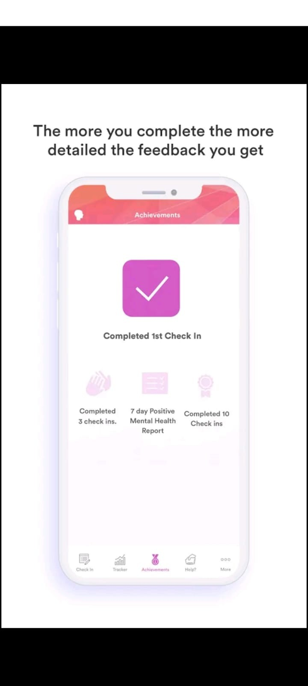
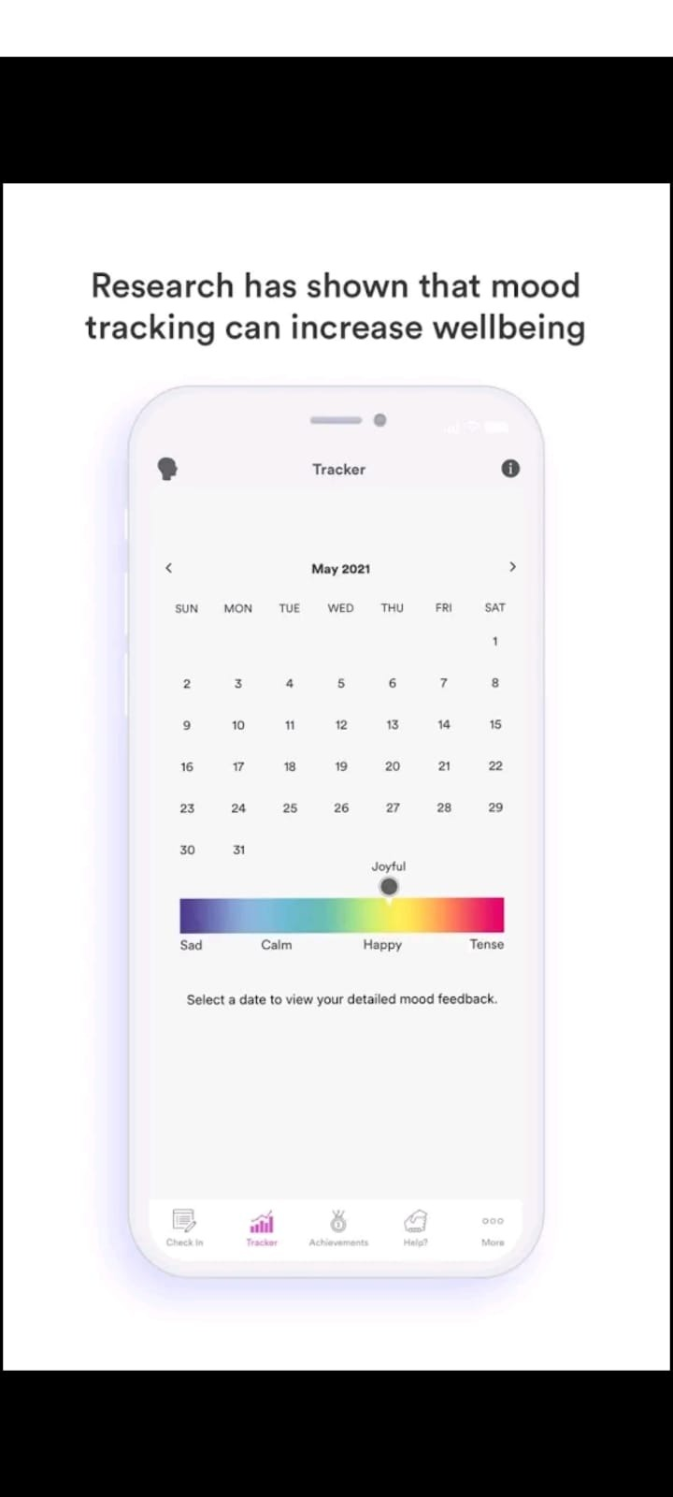
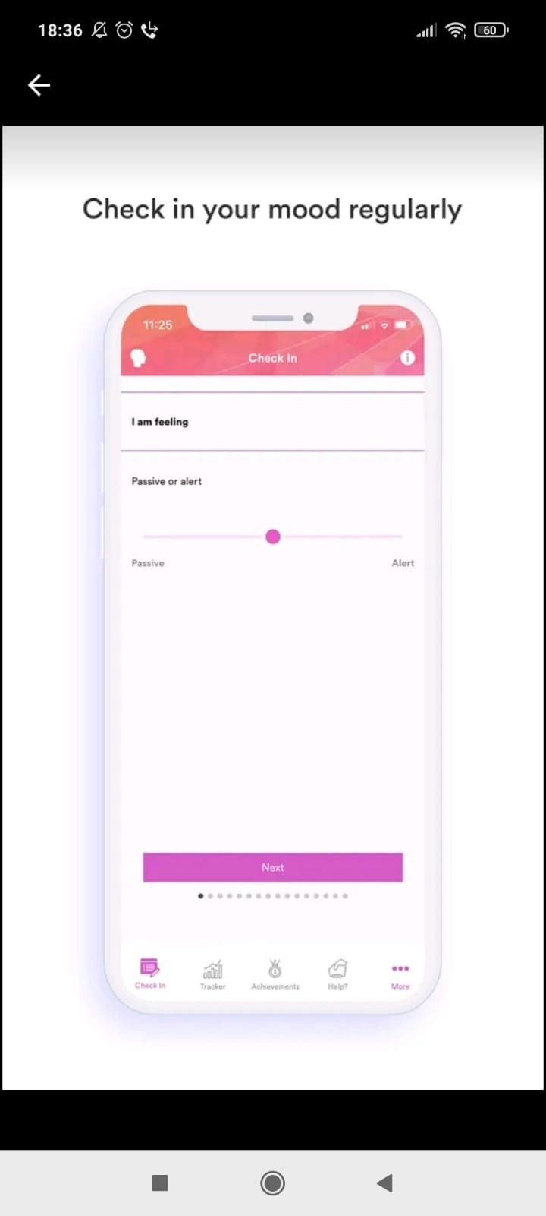
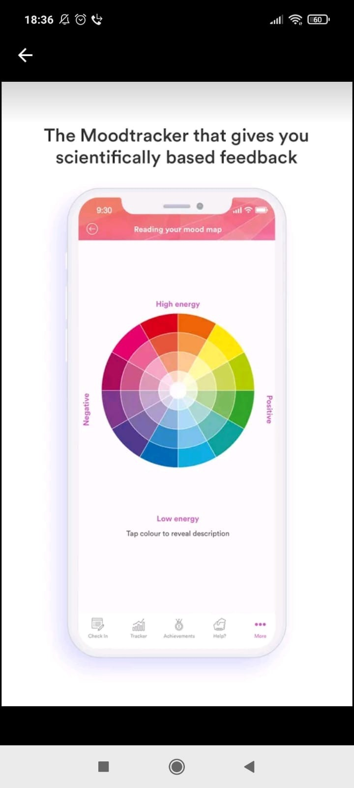
Mood Prism
It is not free so I could not check it.
It transforms emotional health to colourful moodpsrims. It asks series of question and also has open text field to write what you are feeling

Slide 4
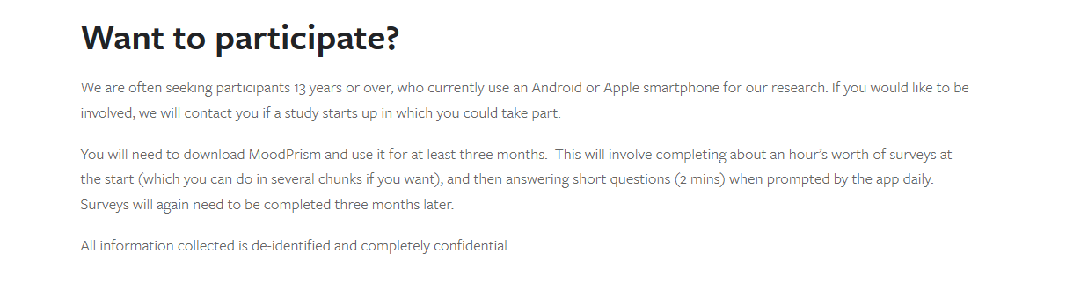

Slide 5

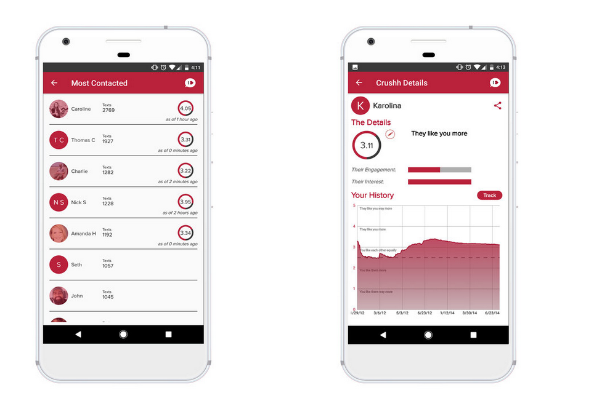

Slide 6
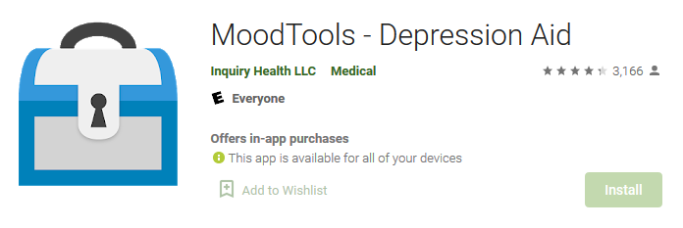
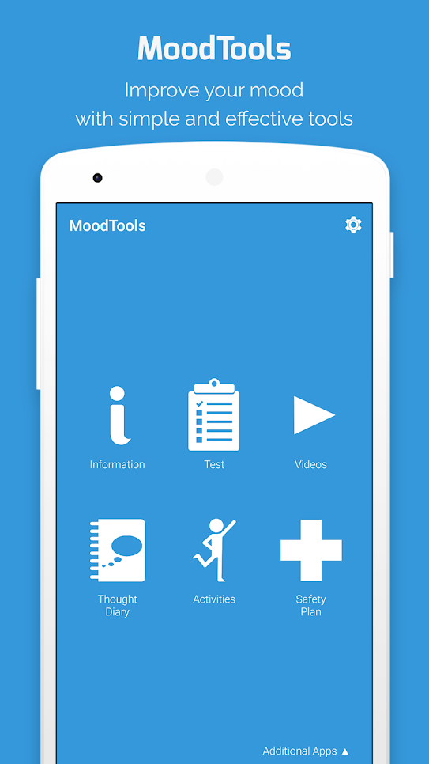
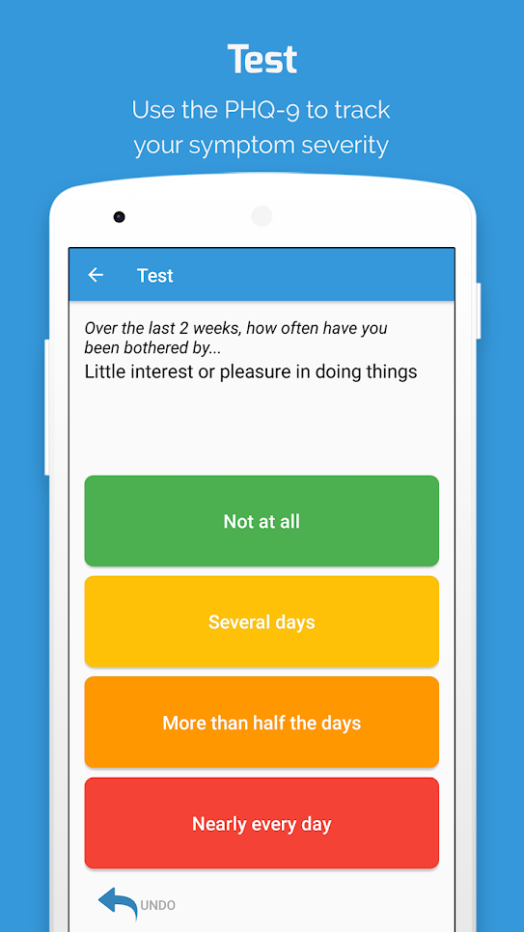
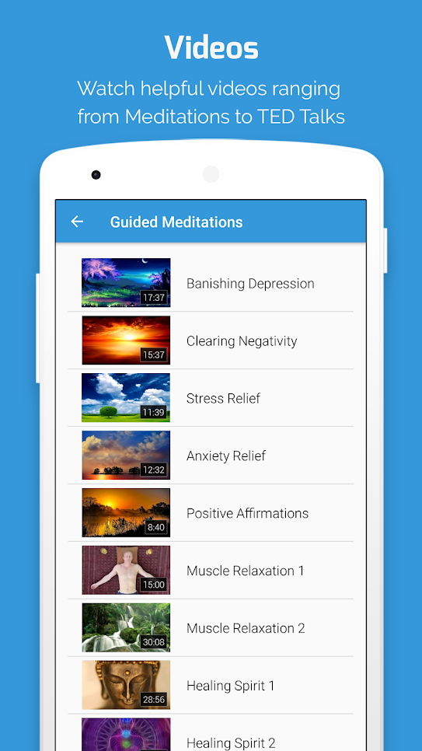

Slide 7
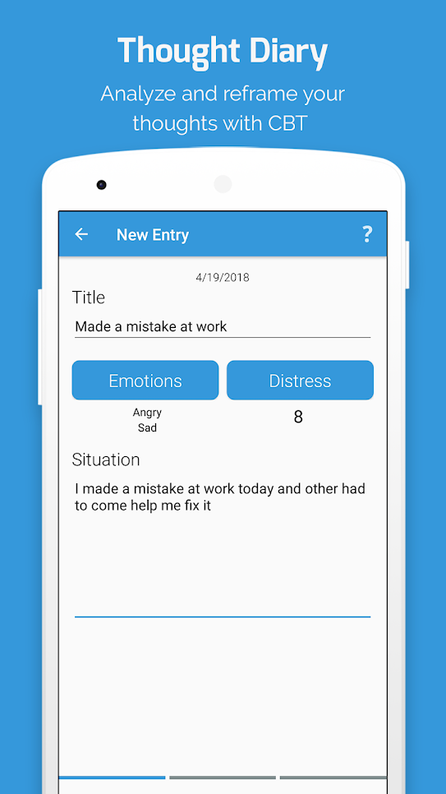
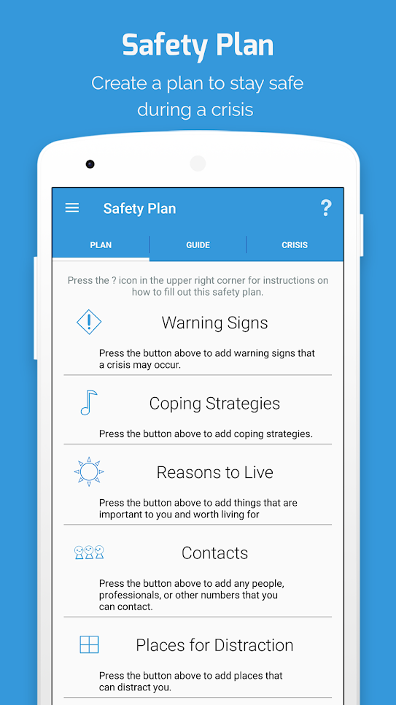

Slide 8
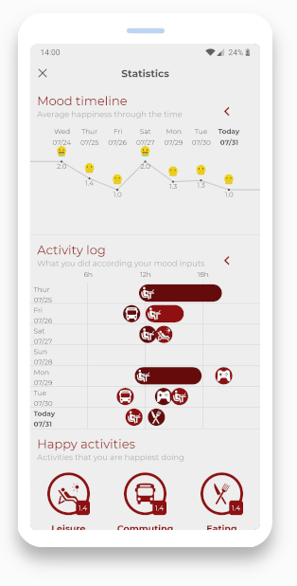
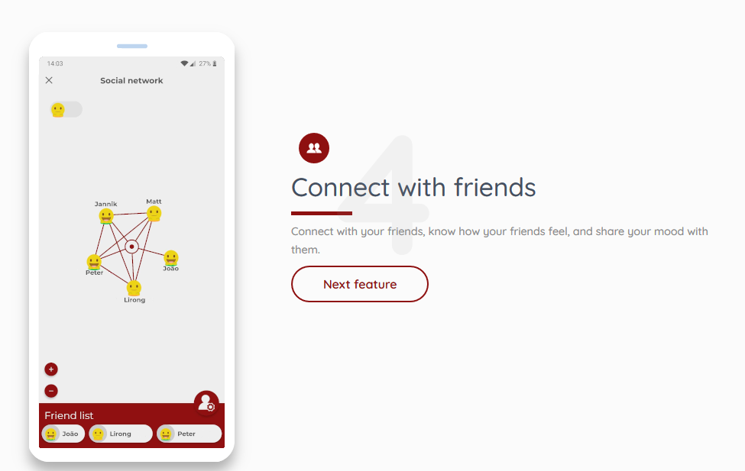
Happimeter
Collects data from smart phone and watch
Review mood by location

Slide 9

OTHER MATERIALS

Slide 10
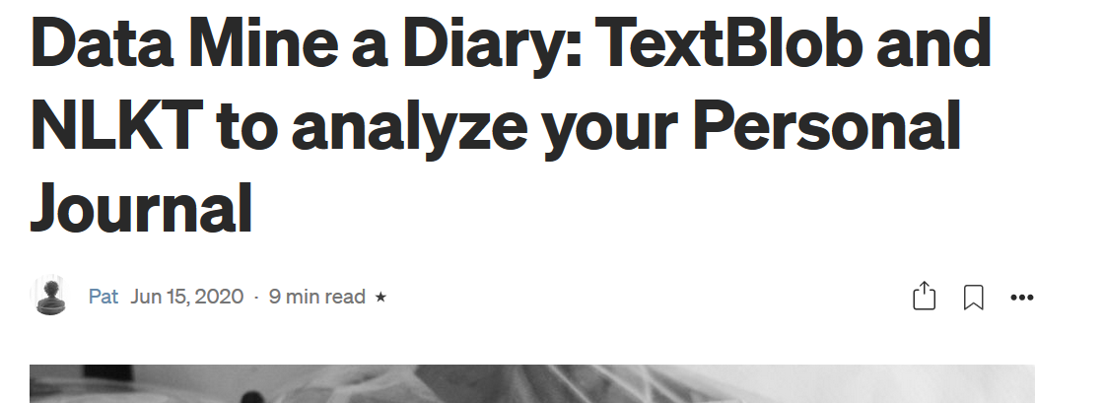
https://towardsdatascience.com/data-mine-a-diary-textblob-and-nlkt-to-analyze-your-personal-journal-a7c73f412acc

Slide 11
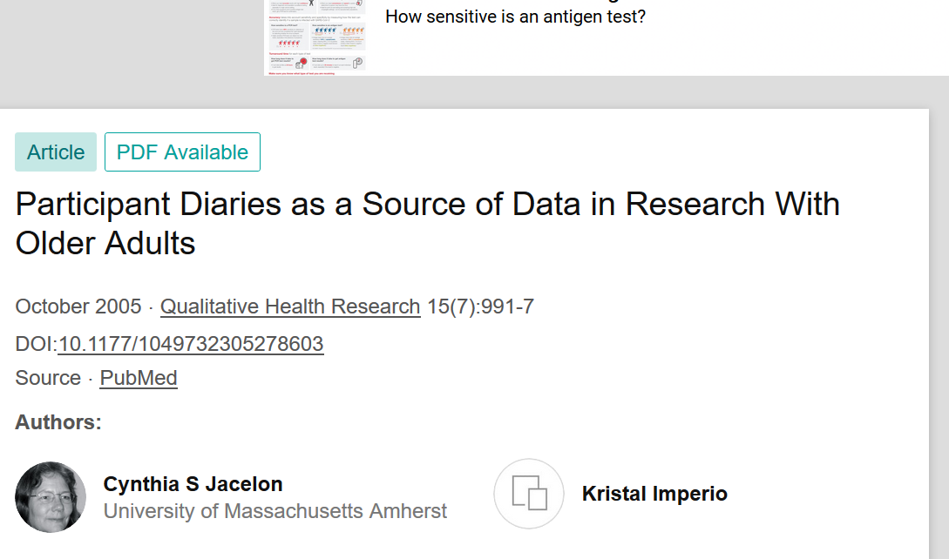
https://www.researchgate.net/publication/7667744_Participant_Diaries_as_a_Source_of_Data_in_Research_With_Older_Adults

Slide 12
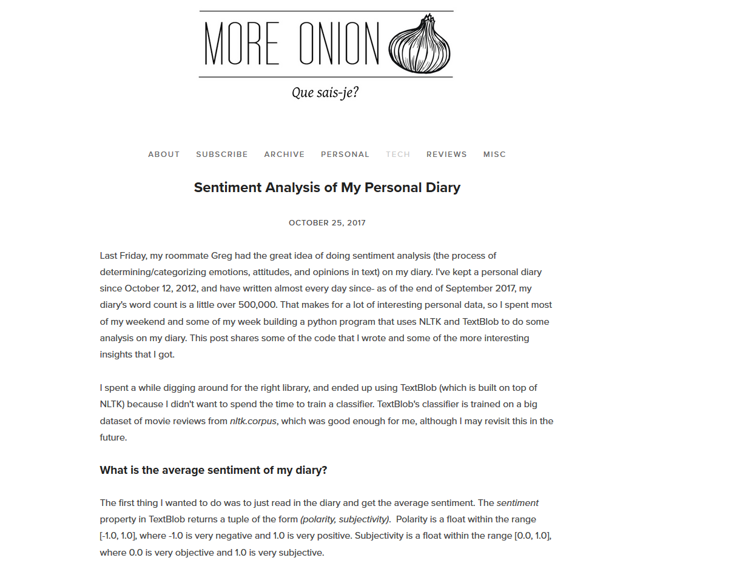
http://www.more-onions.com/tech/2017/10/24/sentiment-analysis-of-my-personal-diary

Slide 13
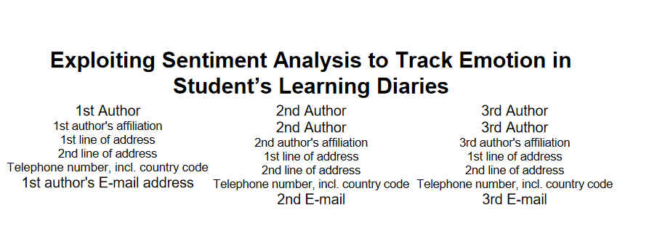
https://www.researchgate.net/publication/262353838_Exploiting_sentiment_analysis_to_track_emotions_in_students%27_learning_diaries

Slide 14
